Slide 1



in the context of DUAL Education
in the Slovak Republic
4th of October 2017, Ljubljana

Slide 2





FACTS | Key principles of the Slovak Dual system
Theoretical education
(runs at school)
Practical education
(runs at employer in range of min.50-60% of the study)
EMPLOYER
+
=
Dual contract
SCHOOL
There is a possibility of getting an exclusive employment contract at the particular employer after successful graduation
EMPLOYER
STUDENT
+
=
Learning contract

Slide 3
What was the history of establishing the Dual system?
VET (Vocational education and training)
the roots in 70´s
till 1989 | Active participation of state owned companies
90´s | Collapse of employers´ participation in VET due to Slovak economy transformation
2002 - 2012 | Employers from automotive sector equipped 12 pilot training centres in VET schools
2009 | New law for VET introduced - focus on more intensive involvement of employers
2012 | Proposal for VET Transformation
no improvements in quality

Slide 4
What was the history of establishing the Dual system?
2013 | National project „Development of vocational education and training in Slovakia“
2014 - 2015 | A brand new concept of the Dual education system developed
2015 | New legislation for VET including the Dual system approved (effective as of 1st April 2015)
2015 | Board of employers for VET was founded
2015 | Analysis on VET in following states (Austria, Germany, Swiss, Finland and Singapore)
was elaborated as the basis for continuation of the VET Transformation in Slovakia till 2020
high employers involvement

Slide 5
What is the current situation of the Dual system?
  422 students in the dual system in school year 2015/2016
  1 121 new students in the dual system in school year 2016/2017
 | Status for school year 2015/16 (02.09.2015) |  | Offer for school year 2016/17 (31.01.2016) | Status for school 2016/17 (02.09.2016) | Offer for school year 2017/18 (31.01.2017)
Number of employers in dual system | 87 |  | 298 | 142 | 256
Number of education places | 115 |  | 494 | 172 | 410
Number of involved schools | 25 |  | 114 | 57 | 96
Number of learning programs | 22 |  | 84 | 48 | 76

Slide 6
What are the main benefits and challenges of the Dual system?
BENEFITS
CHALLENGES
adopting working habits directly at employers
learning by doing (practical trainings on employers premises)
being face to face to new technologies
smooth transition to job market
(high-skilled employees / no probation period)
succesful transfer of labour market needs into education system
opportunity for job vacancy guaranteed after graduation (high probability of getting working contract)
verification of students knowledge, skills during practical education at employers
improvement in students´ motivation (their attendance, discipline, study results)
individual approach to students through employer´s instructor
employers impact on the content of vocational education
lack of information about dual education amongst pupils and their parents
insufficient promotion and poor propagation of systems advantages
poor training for career guides at elementary schools
missing analysis of pupils´ potential and predispositions for a job
decreasing number of students interested in VET
missing students´ manual skills and attitude to work
inappropriate structure of VET programs: more quantity than quality
actual capacity planning does not fully reflect labour market needs
schools and employers disinterest to enter the system
insufficient support and motivation for entering the system (legal / financial / administrative / tech. aspect)

Slide 7
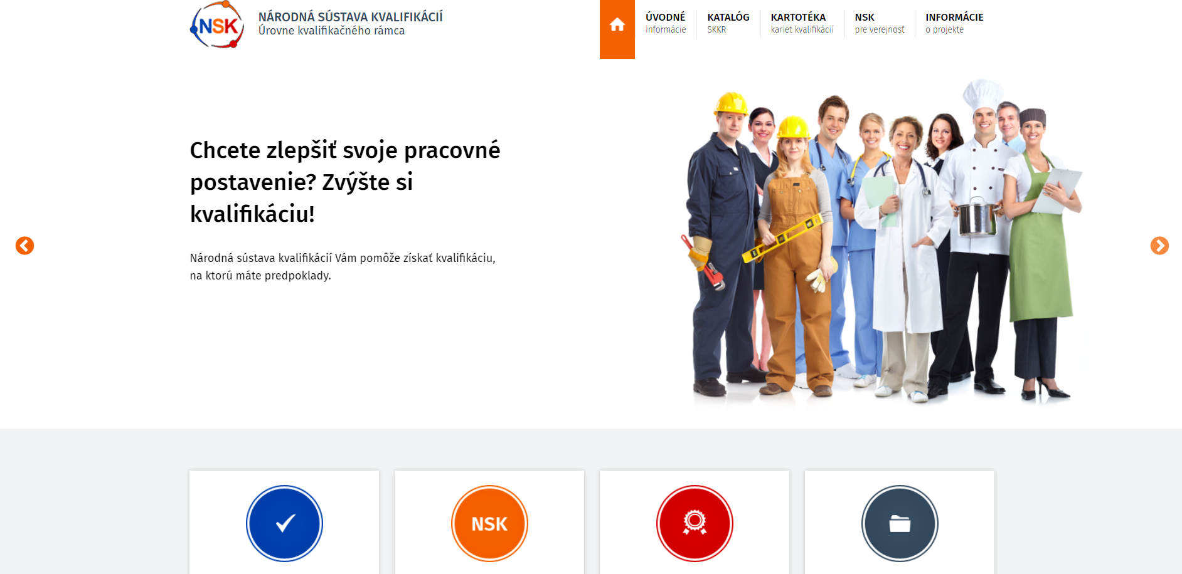
National Qualifications System
the nation-wide system of validation of non-formal education and informal learning
register with comprehensive description of qualifications
1 000 identified and described qualifications
register with Qualification Cards
definition of educational pathway/requirement on recognition
www.kvalifikacie.sk

Slide 8
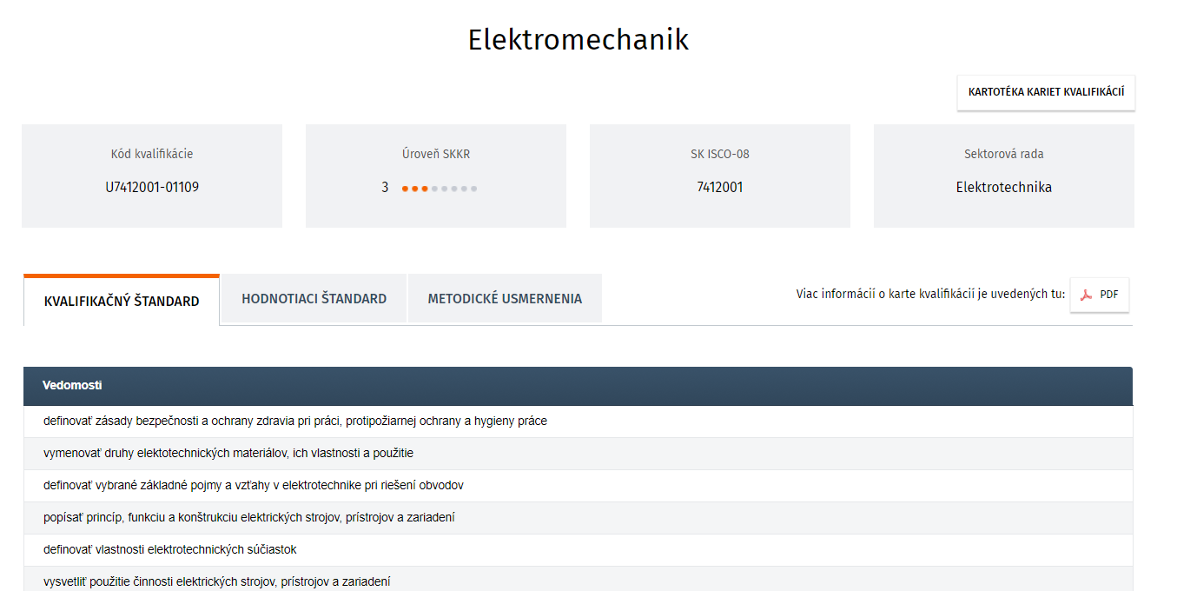
National Qualifications System
QUALIFICATION CARD
Fundaments:
Qualification standard
knowledge
skills
competences
Assessment standard
contents
institution
method

Slide 9


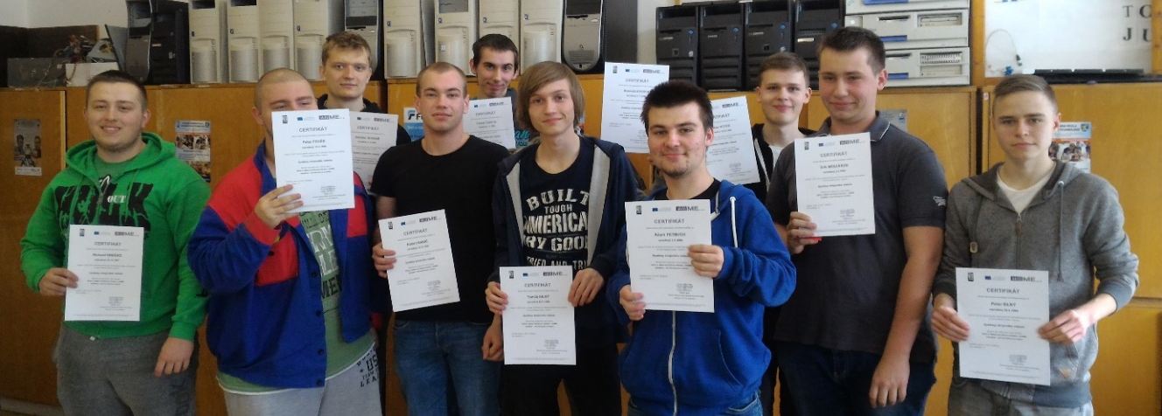
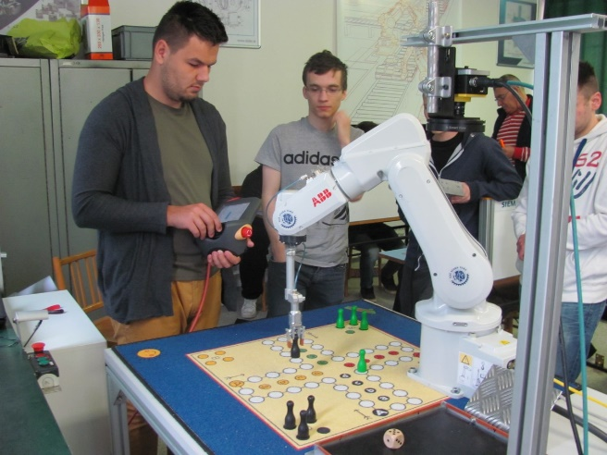
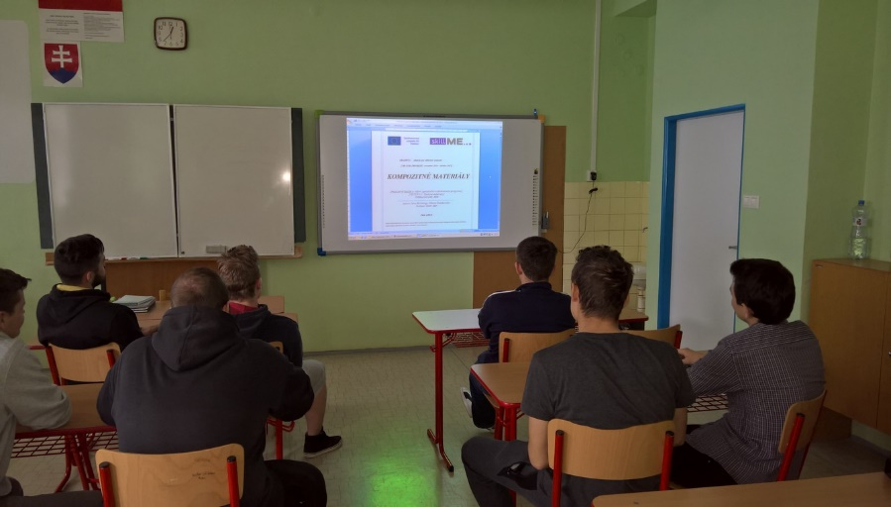
How projects like skillME are being helpful for the dual education?
SOŠ IT, Bratislava
SOŠ, Stará Turá
Course on composite materials
(traditional vrs. new ones)
CAD / CAM course
(CNC machine programing)
Course on technical documentation reading
(in metal and electro-technical industry)
Course on machine vision systems
(image processing using industrail cameras)
motivation increase to learn new technologies
great promotion of VET including the Dual system
intensive cooperation amongst teachers and students

Slide 10
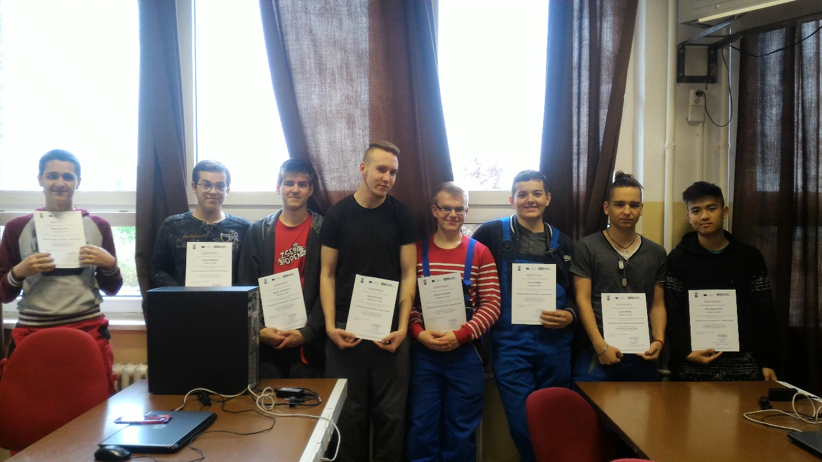
THANK YOU FOR YOUR ATTENTION!
„A craft has
a golden bottom...“

